Slide 1
UPPER SIXTH ARTS
GEOGRAPHY
Lesson 31
Tourism
Notes:
Good morning, class, and welcome to our geography lesson. I am your geography teacher, Mr Kamdem. Today we are starting Lesson 31: Tourism.

Slide 2
CLASS INFO
Class, Chapter and Duration
Class | Upper Sixth Arts
Chapter | Module 6: Understanding and managing the dynamics of economic activities across the world in general and Cameroon in particular
Duration | 2 periods (2 × 50 minutes)
Notes:
This lesson is for Upper Sixth Arts. It belongs to Module 6: Understanding and managing the dynamics of economic activities across the world in general and Cameroon in particular. We shall need 2 periods to cover it.

Slide 3
IDENTIFICATION
Lesson Identification
Topic | Tourism Activities
Sub-topic | World (Global) Tourism
Lesson | Lesson 31: Tourism
Notions / Concepts | Tourism, tourist, destination, mass tourism, ecotourism, Butler model.
Syllabus focus | Meaning; types and categories of tourists; major origins and destinations; resources, facilities and activities; impacts; growth and factors; measures to promote tourism; Butler's model.
Competence | Learners are able to explain world tourism, its impacts and its evolution.
Notes:
Our topic is Tourism Activities, and the sub-topic is World (Global) Tourism. The key notions we shall use today are: tourism, tourist, destination, mass tourism, ecotourism, Butler model. At the end, you should be able to do this: learners are able to explain world tourism, its impacts and its evolution.

Slide 4

HOMEWORK CORRECTION
Correction of the Homework
Question (Further Study 6: Transport Development in Cameroon):
Describe the state of the main road near your school and suggest improvements.
Notes:
Before we start the new lesson, let us correct the homework I gave you at the end of Further Study 6: Transport Development in Cameroon. The question was: Describe the state of the main road near your school and suggest improvements. Take out your exercise books.

Slide 5
HOMEWORK CORRECTION
Correction: Possible Answer
Answers vary. Example: the road is untarred with potholes and floods in the rainy season. Improvements: tar it, build drains and culverts, and maintain it regularly.
Notes:
Here is a good answer. Answers vary. Example: the road is untarred with potholes and floods in the rainy season. Improvements: tar it, build drains and culverts, and maintain it regularly. Compare it with your own answer and correct your work in red.

Slide 6
LESSON PLAN
Lesson Plan
Correction of the homework
Objectives and recall
Real-life situation and action to take
Learning activities
Board summary
Evaluation, remediation and homework
Notes:
Here is the plan of our lesson today. First, we shall correct the homework. Then we shall look at the objectives and recall what you already know. After that, we shall study a situation from real life and the action to take, and do the learning activities. Finally, we shall copy the board summary, do the evaluation and the remediation, and I will give you the homework.

Slide 7
OBJECTIVES
Objectives
By the end of this lesson, you should be able to:
Define tourism and classify its types.
Describe origins, destinations and factors of growth.
Notes:
Take your time to copy this part; we will continue together.

Slide 8
OBJECTIVES
Objectives (continued)
Explain the impacts of tourism and the Butler model.
Notes:
By the end of this lesson, you should be able to do three things. Number 1: define tourism and classify its types. Number 2: describe origins, destinations and factors of growth. Number 3: explain the impacts of tourism and the Butler model.

Slide 9
PREVIOUS KNOWLEDGE
Previous Knowledge
People travel for holidays.
Cameroon has beaches, mountains and parks.
Notes:
Let us first remember what you already know. People travel for holidays. Cameroon has beaches, mountains and parks. Keep this in mind, because we shall build on it today.

Slide 10
REAL-LIFE SITUATION
Situation in Real Life
European tourists visit the beaches of Kribi and the park of Waza. They spend money in hotels and markets, but some beaches become dirty and local customs change.
Notes:
Listen carefully to this situation from real life. European tourists visit the beaches of Kribi and the park of Waza. They spend money in hotels and markets, but some beaches become dirty and local customs change. Think about it, because I am going to ask you some questions.

Slide 11
REAL-LIFE SITUATION
Situation: Question 1
What is the problem in the situation?
Notes:
Question 1: What is the problem in the situation? Think for a moment, then raise your hand to answer.

Slide 12
REAL-LIFE SITUATION
Answer
Tourism brings money but also problems.
Notes:
Good. Tourism brings money but also problems.

Slide 13
REAL-LIFE SITUATION
Situation: Question 2
Name two tourist attractions in the situation.
Notes:
Question 2: Name two tourist attractions in the situation. Think for a moment, then raise your hand to answer.

Slide 14
REAL-LIFE SITUATION
Answer
Kribi beaches and Waza park.
Notes:
Good. Kribi beaches and Waza park.

Slide 15
REAL-LIFE SITUATION
Situation: Question 3
Give one problem of tourism.
Notes:
Question 3: Give one problem of tourism. Think for a moment, then raise your hand to answer.

Slide 16
REAL-LIFE SITUATION
Possible Answer
Pollution of beaches (or change in local customs).
Notes:
Good. Pollution of beaches (or change in local customs).

Slide 17
ACTION TO TAKE
Action to Take
Protect tourist sites and welcome visitors respectfully.
Notes:
From this situation, the action we are working towards in this lesson is the following: protect tourist sites and welcome visitors respectfully.

Slide 18
JUSTIFICATION
Justification of the Lesson
This lesson helps us to understand tourism and how to manage it.
Notes:
Why is this lesson important for you? This lesson helps us to understand tourism and how to manage it.

Slide 19

1. MEANING AND TYPES OF TOURISM
Activity 1
A crowded beach resort.
Notes:
Activity 1. Look carefully at this picture: a crowded beach resort. Observe every detail before I ask the question.

Slide 20
1. MEANING AND TYPES OF TOURISM
Activity 1: Question
Distinguish mass tourism and ecotourism.
Notes:
Here is the question for Activity 1: Distinguish mass tourism and ecotourism. Take one minute to think and write your answer in your rough notebook.

Slide 21
1. MEANING AND TYPES OF TOURISM
Activity 1: Answer
Mass tourism: many tourists in resorts. Ecotourism: small groups visiting nature with care for the environment.
Notes:
Let us check the answer together. Mass tourism: many tourists in resorts. Ecotourism: small groups visiting nature with care for the environment.

Slide 22
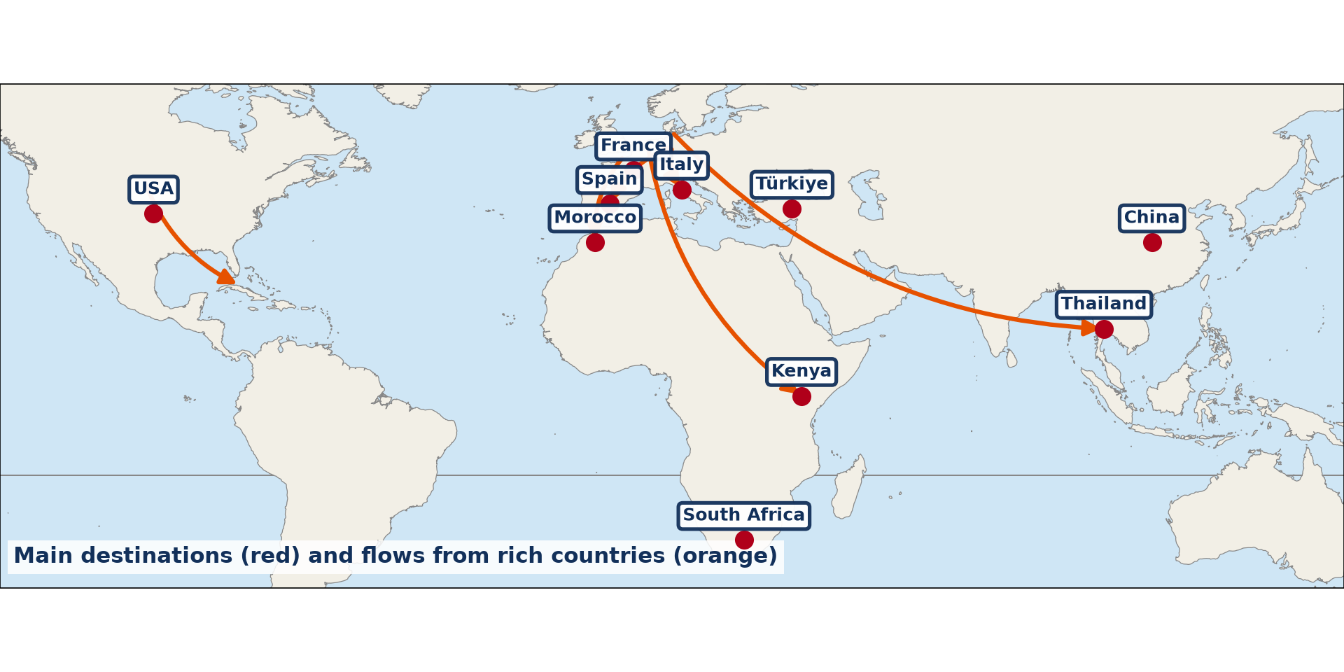
2. ORIGINS AND DESTINATIONS
Activity 2
Main tourist flows.
Notes:
Activity 2. Look carefully at this diagram: main tourist flows. Observe every detail before I ask the question.

Slide 23
2. ORIGINS AND DESTINATIONS
Activity 2: Question
Which region sends and receives most tourists?
Notes:
Here is the question for Activity 2: Which region sends and receives most tourists? Take one minute to think and write your answer in your rough notebook.

Slide 24
2. ORIGINS AND DESTINATIONS
Activity 2: Answer
Europe.
Notes:
Let us check the answer together. Europe.

Slide 25
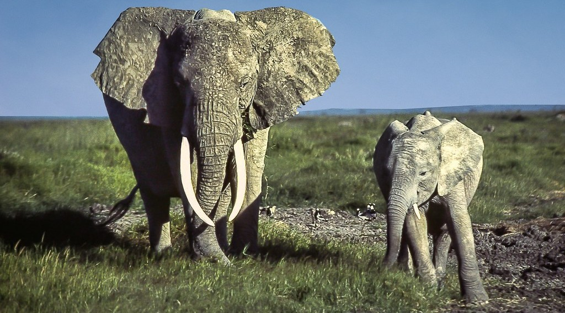
3. RESOURCES AND ACTIVITIES
Activity 3
Wildlife in an African park.
Notes:
Activity 3. Look carefully at this picture: wildlife in an African park. Observe every detail before I ask the question.

Slide 26
3. RESOURCES AND ACTIVITIES
Activity 3: Question
Give two natural and two human tourist resources.
Notes:
Here is the question for Activity 3: Give two natural and two human tourist resources. Take one minute to think and write your answer in your rough notebook.

Slide 27
3. RESOURCES AND ACTIVITIES
Activity 3: Answer
Natural: wildlife, beaches. Human: monuments, festivals.
Notes:
Let us check the answer together. Natural: wildlife, beaches. Human: monuments, festivals.

Slide 28
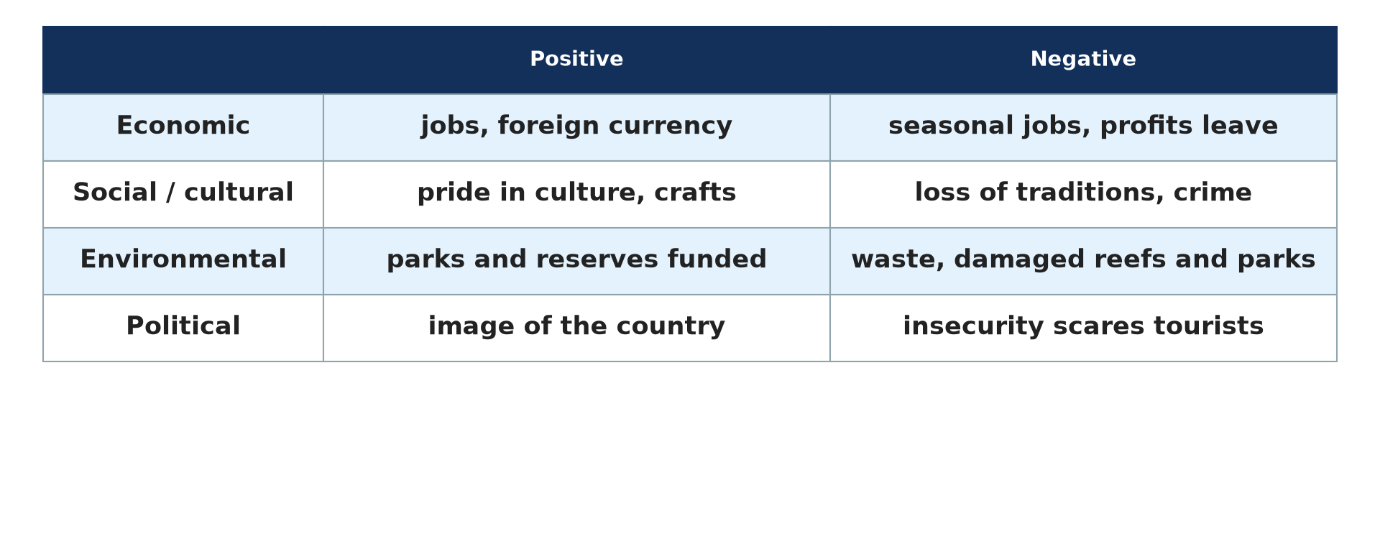
4. IMPACTS OF TOURISM
Activity 4
Positive and negative impacts.
Notes:
Activity 4. Look carefully at this diagram: positive and negative impacts. Observe every detail before I ask the question.

Slide 29
4. IMPACTS OF TOURISM
Activity 4: Question
Give two positive and two negative impacts of tourism.
Notes:
Here is the question for Activity 4: Give two positive and two negative impacts of tourism. Take one minute to think and write your answer in your rough notebook.

Slide 30
4. IMPACTS OF TOURISM
Activity 4: Answer
Positive: jobs, foreign currency. Negative: pollution, loss of culture.
Notes:
Let us check the answer together. Positive: jobs, foreign currency. Negative: pollution, loss of culture.

Slide 31
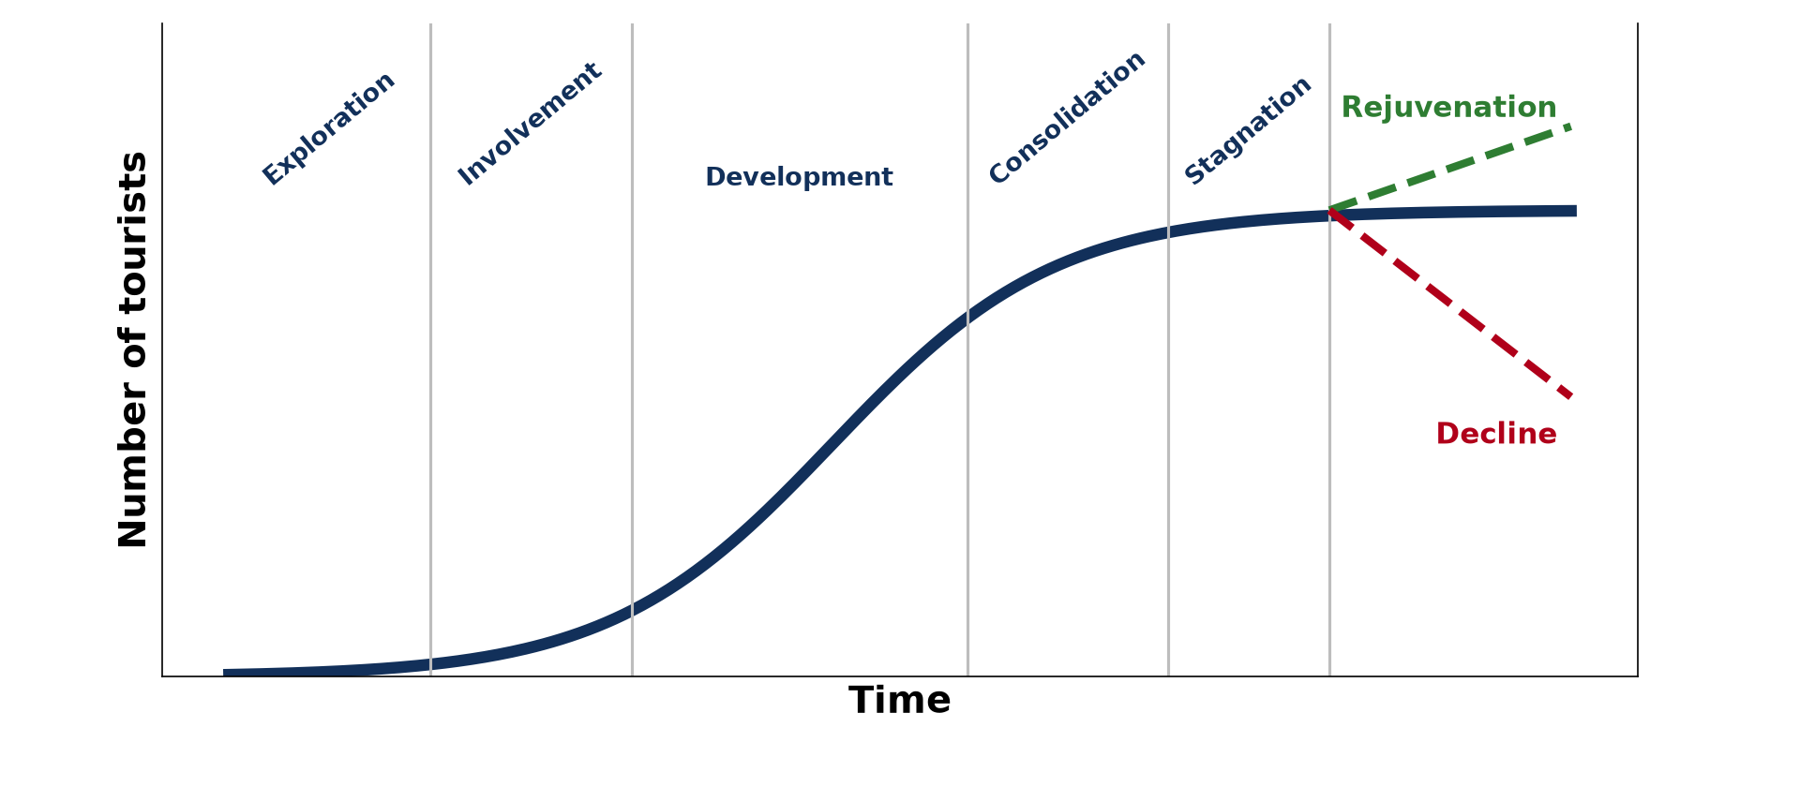
5. BUTLER'S MODEL
Activity 5
Butler's tourist area life cycle.
Notes:
Activity 5. Look carefully at this diagram: butler's tourist area life cycle. Observe every detail before I ask the question.

Slide 32
5. BUTLER'S MODEL
Activity 5: Question
What can happen after stagnation?
Notes:
Here is the question for Activity 5: What can happen after stagnation? Take one minute to think and write your answer in your rough notebook.

Slide 33
5. BUTLER'S MODEL
Activity 5: Answer
Decline, or rejuvenation if the resort is improved.
Notes:
Let us check the answer together. Decline, or rejuvenation if the resort is improved.

Slide 34
BOARD SUMMARY
Board Summary
Topic: Tourism Activities
Sub-topic: World (Global) Tourism
Lesson 31: Tourism
Notes:
Now we are going to copy the board summary. Write the title and the headings neatly in your notebooks. I will give you enough time for each slide, so do not rush.

Slide 35
BOARD SUMMARY
1. Meaning and Nature of Tourism
Tourism and its types can be defined as follows:
Tourism: It is travel for leisure, business or culture outside one's usual home for at least one night. A tourist is a person who travels for this purpose.
Notes:
Let us copy Meaning and Nature of Tourism. Tourism and its types can be defined as follows. On this slide we have Tourism. Write each point on a new line, with the key term first, and explain it in your own words when we revise. When you finish, we go to the next slide.

Slide 36
BOARD SUMMARY
1. Meaning and Nature of Tourism (continued)
Types of tourism: Mass tourism brings many people to resorts, while ecotourism is responsible travel to natural areas. Cultural, business and religious tourism also exist.
Notes:
We continue with Meaning and Nature of Tourism. On this slide we have Types of tourism. Write each point on a new line, with the key term first, and explain it in your own words when we revise. When you finish, we go to the next slide.

Slide 37
BOARD SUMMARY
1. Meaning and Nature of Tourism (continued)
Categories of tourists: Domestic tourists travel within their own country, and international tourists cross borders. Tourists can also be grouped by age, income or purpose.
Notes:
We continue with Meaning and Nature of Tourism. On this slide we have Categories of tourists. Write each point on a new line, with the key term first, and explain it in your own words when we revise.

Slide 38
BOARD SUMMARY
2. Origins, Destinations and Growth
World tourism is organised as follows:
Origins and destinations: Europe, North America and East Asia send most tourists. France, Spain, the USA and Italy receive the most.
Notes:
Let us copy Origins, Destinations and Growth. World tourism is organised as follows. On this slide we have Origins and destinations. Write each point on a new line, with the key term first, and explain it in your own words when we revise. When you finish, we go to the next slide.

Slide 39
BOARD SUMMARY
2. Origins, Destinations and Growth (continued)
Factors of growth: Higher incomes, paid holidays and cheap flights have increased tourism. The internet, peace and good advertising also help.
Notes:
We continue with Origins, Destinations and Growth. On this slide we have Factors of growth. Write each point on a new line, with the key term first, and explain it in your own words when we revise.

Slide 40
BOARD SUMMARY
2. Origins, Destinations and Growth
Illustration: main tourist flows
Notes:
Now draw this illustration in your notebook: main tourist flows. Give it a title and label it clearly.

Slide 41
BOARD SUMMARY
3. Resources, Facilities and Activities
Tourism depends on the following resources and facilities:
Tourist resources: Natural resources include beaches, mountains and wildlife. Human resources include monuments, festivals and cultures.
Notes:
Let us copy Resources, Facilities and Activities. Tourism depends on the following resources and facilities. On this slide we have Tourist resources. Write each point on a new line, with the key term first, and explain it in your own words when we revise. When you finish, we go to the next slide.

Slide 42
BOARD SUMMARY
3. Resources, Facilities and Activities (continued)
Facilities and activities: Hotels, transport and travel agencies receive tourists. Tourists go sightseeing, bathing, hiking and on safari.
Notes:
We continue with Resources, Facilities and Activities. On this slide we have Facilities and activities. Write each point on a new line, with the key term first, and explain it in your own words when we revise.

Slide 43
BOARD SUMMARY
4. Impacts and Promotion of Tourism
Tourism has impacts and can be promoted as follows:
Positive impacts: Tourism creates jobs and brings foreign currency. It also builds infrastructure and can protect nature and culture.
Notes:
Let us copy Impacts and Promotion of Tourism. Tourism has impacts and can be promoted as follows. On this slide we have Positive impacts. Write each point on a new line, with the key term first, and explain it in your own words when we revise. When you finish, we go to the next slide.

Slide 44
BOARD SUMMARY
4. Impacts and Promotion of Tourism (continued)
Negative impacts: It can cause pollution, high prices and loss of culture. Profits often leave the host country.
Promotion measures: Advertising, security and good infrastructure attract tourists. Training staff also improves the quality of service.
Notes:
We continue with Impacts and Promotion of Tourism. On this slide we have Negative impacts and Promotion measures. Write each point on a new line, with the key term first, and explain it in your own words when we revise.

Slide 45
BOARD SUMMARY
4. Impacts and Promotion of Tourism
Illustration: impacts of tourism
Notes:
Now draw this illustration in your notebook: impacts of tourism. Give it a title and label it clearly.

Slide 46
BOARD SUMMARY
5. Butler's Model of Tourist Area Evolution
Butler (1980) described the life cycle of a resort as follows:
Early stages: In exploration, few tourists come to an unspoiled place. In involvement and development, locals and companies build facilities and numbers rise fast.
Notes:
Let us copy Butler's Model of Tourist Area Evolution. Butler (1980) described the life cycle of a resort as follows. On this slide we have Early stages. Write each point on a new line, with the key term first, and explain it in your own words when we revise. When you finish, we go to the next slide.

Slide 47
BOARD SUMMARY
5. Butler's Model of Tourist Area Evolution (continued)
Later stages: In consolidation growth slows, and in stagnation the resort is crowded and loses appeal. It then declines or is rejuvenated by new attractions.
Notes:
We continue with Butler's Model of Tourist Area Evolution. On this slide we have Later stages. Write each point on a new line, with the key term first, and explain it in your own words when we revise.

Slide 48
BOARD SUMMARY
5. Butler's Model of Tourist Area Evolution
Illustration: Butler's tourist area life cycle
Notes:
Now draw this illustration in your notebook: butler's tourist area life cycle. Give it a title and label it clearly.

Slide 49
FORMATIVE EVALUATION
Evaluation 1
Give two factors for the growth of world tourism.
Notes:
Now let us check what you have understood. Question 1: Give two factors for the growth of world tourism. Answer in your exercise book.

Slide 50
FORMATIVE EVALUATION
Expected Answer
Higher incomes and cheaper air travel.
Notes:
The expected answer is: higher incomes and cheaper air travel. If you got it right, well done.

Slide 51
FORMATIVE EVALUATION
Evaluation 2
Name the stages of Butler's model.
Notes:
Now let us check what you have understood. Question 2: Name the stages of Butler's model. Answer in your exercise book.

Slide 52
FORMATIVE EVALUATION
Expected Answer
Exploration, involvement, development, consolidation, stagnation, then decline or rejuvenation.
Notes:
The expected answer is: exploration, involvement, development, consolidation, stagnation, then decline or rejuvenation. If you got it right, well done.

Slide 53
REMEDIATION
Remediation
Fill in the blanks:
Travel to nature that protects it is ______.
The largest tourist region is ______.
Butler's stage after development is ______.
Notes:
For those who need more practice, fill in the blanks in your exercise book. The answers are: number 1, ecotourism; number 2, Europe; number 3, consolidation.

Slide 54
HOMEWORK
Homework
Choose a tourist site in Cameroon and place it on a stage of Butler's model.
Notes:
For your homework: Choose a tourist site in Cameroon and place it on a stage of Butler's model. We shall correct it at the beginning of our next lesson.

Slide 55
NEXT LESSON
Next Lesson
Our next lesson will be on:
Further Study 7: Tourism Development in Cameroon
Notes:
Our next lesson will be on Further Study 7: Tourism Development in Cameroon. Thank you for your attention, and see you next time.

Slide 56
BILINGUAL GAME
Bilingual Game (Jeu Bilingue)
English | Français
Tourism | Le tourisme
Tourist | Le touriste
Destination | La destination
Hotel | L'hôtel
Beach | La plage
Wildlife | La faune
Notes:
Let us play the bilingual game. I say a word in English, and you give me the French word. Then we do the reverse.

Slide 57
LOGBOOK
Official Logbook (1/2)
Module / Topic | Tourism Activities
Lesson Title | Lesson 31: Tourism
Expected Learning Outcomes | Define tourism and classify its types. Describe origins, destinations and factors of growth. Explain the impacts of tourism and the Butler model.
Competence | Learners are able to explain world tourism, its impacts and its evolution.
Notes:
I record this information in the official logbook of the class after the lesson.

Slide 58
LOGBOOK
Official Logbook (2/2)
Matter Taught | Meaning and Nature of Tourism; Origins, Destinations and Growth; Resources, Facilities and Activities; Impacts and Promotion of Tourism; Butler's Model of Tourist Area Evolution.
Evaluation | Formative evaluation and remediation exercise.
Homework | Choose a tourist site in Cameroon and place it on a stage of Butler's model.
Enrolment / Present / Absent | ____ / ____ / ____
Achievement | To be completed after the lesson.
Notes:
I complete the second page of the logbook: the matter taught, the evaluation, the homework and the attendance.

Slide 59
TEACHER'S NOTE
Teacher's Note
Timing: Homework correction, plan, objectives 8 min | Recall, situation, action 10 min | 5 activities 30 min | Board summary (copying) 30 min | Evaluation, remediation 10 min | Homework, next lesson 5 min | Logbook 7 min
Without the projector (Activity 1): give examples.
Without the projector (Activity 2): read the flows.
Without the projector (Activity 3): list attractions.
Without the projector (Activity 4): sort the impacts.
Without the projector (Activity 5): describe the curve.
Notes:
This slide is for me, the teacher: it gives the timing of the lesson and what to do if the projector is not available.

Slide 60
REFERENCES
References
National Geography Syllabus, MINESEC/IGE/IP-SS, 2019 — Module 6 (Economic Geography).
Photo, Activity 1: “Crowded Sunny Beach, Bulgaria” by phototouring, CC BY-NC-SA 2.0, via Flickr (https://www.flickr.com/photos/19054742@N00/1557605901)
Photo, Activity 3: “African Bush Elephant, Amboseli National Park, Kenya” by Ray in Manila, CC BY 2.0, via Flickr (https://www.flickr.com/photos/21186555@N07/37211779966)
Diagrams and animations: drawn for this lesson (Geography Department).
Notes:
These are the references and picture credits used to prepare this lesson.

